Slide 1
CS 2001 Data Structures
Week 3
Lecture 2

Slide 2
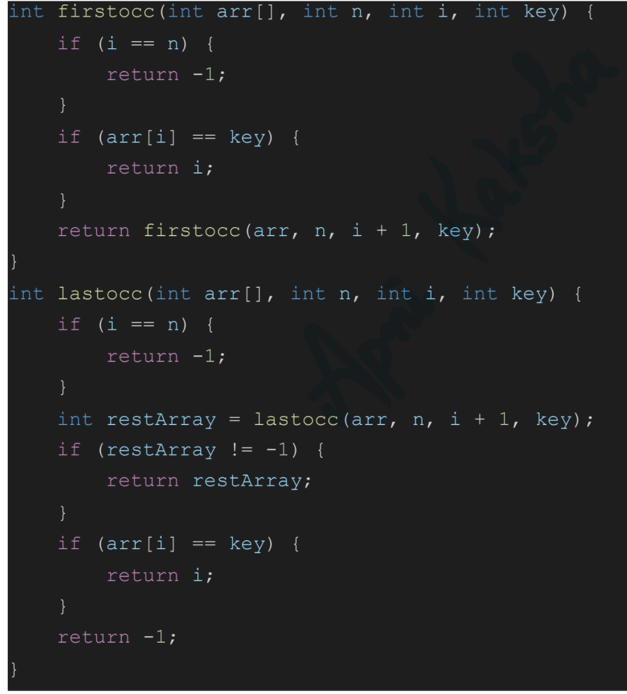
Find the first and last occurrence of an element using recursion

Slide 3
Classification of Recursion
Tail vs. Non-Tail
Direct vs. Indirect
Simple vs. Excessive
Nested Recursion

Slide 4

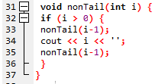
Tail Recursion
Tail Recursion is characterized by the use of only one recursive call at the very end of a function implementation.
This means when a recursive call is invoked there is no work left for the previous call.
Moreover, there is no pending recursive calls, either direct or indirect.

Slide 5
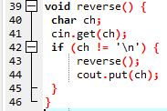
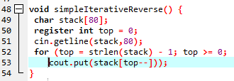
Non tail recursion example
Non-Tail recursion is characterized by the fact that there is still some work left for the first call and a recursive selfcall is invoked.

Slide 6


Tail vs Non Tail Recursion

Slide 7
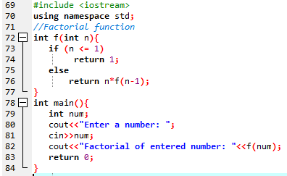
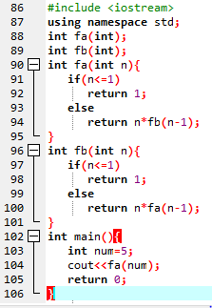
Direct Recursion vs Indirect Recursion
Direct recursion: When function calls itself, it is called direct recursion.
Indirect recursion: When function calls another function and that function calls the calling function, then this is called indirect recursion. For example: function A calls function B and Function B calls function A.

Slide 8
Nested Recursion
When a recursive function call is embedded into a recursive function, it is called “Nested Recursion”
Example of nested recursion is Ackerman function:
A(m,n) = n + 1 if m == 0
A(m,n) = A(m-1, 1) if m > 0 && n == 0
A(m,n) = A(m-1, A(m, n-1)) if m > 0 && n > 0
It is interesting for computational reasons due to the depth of recursion and due to the nested recursion.
For example, A(4, 2) is an integer of 19,729 decimal digits

Slide 9

Excessive Recursion
Some recursive methods repeats the computations for some parameters, which results in long computation time even for simple cases.
This can be implemented in c++ as follows:

Slide 10
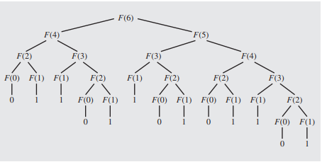
Excessive Recursion
To show how much this formula is inefficient, let us try to see how Fib(6) is evaluated.

Slide 11
Excessive Recursion: Example
For calculating fib(6), the method is called 25 times.
The same calculation are repeated again and again because the system forgets what have been already calculated.
The method is called 2*fib(n+1)-1 times to compute fib(n)
3,000,000 calls are needed to calculate the 31st element.

Slide 12
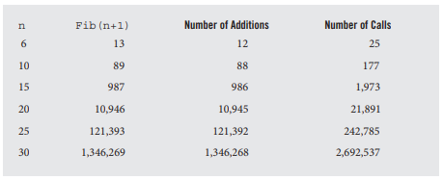
Comparison:
Number of addition operations and number of recursive calls to calculate Fibonacci numbers.

Slide 13
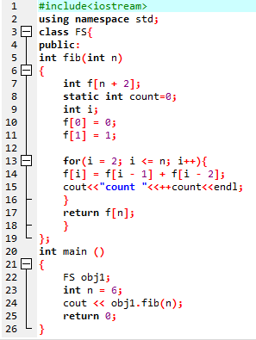
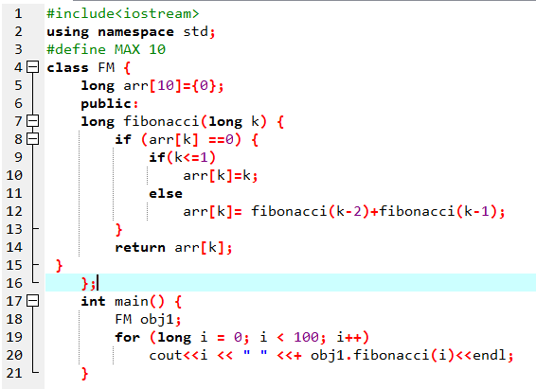
Memoizable Fibonacci recursive:

Slide 14
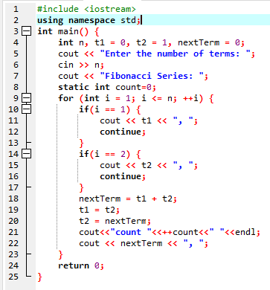
Iterative Method:

Slide 15
Conclusion
Recursion is a programming tool. Like any other topic in data structures, it should be used with good judgment.
Recursive solutions are simplified one for understanding, short and precise code, readability and maintainability are increases.
Sometimes, slow and hard on resources. Specifically available on only compilers that support recursion.
Sometimes recursion is faster than iterative approach. Running a simple routine implemented recursively and iteratively and comparing the two run times can help to decide if recursion is advisable.

Slide 16
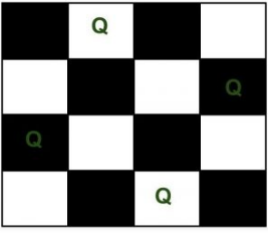
N-Queen Problem
We have N queens and N x N chess board. The objective of this problem is such that we need to place all N queens on N x N chess board in such a manner that no two queens in under attack to each other.
Legal move attacking means no 2 queens in same row, col, and diagonal
Two queens will be under attack if one of the following conditions is true:-
firstly, if they are in the same row.
secondly, if they are in the same column.
finally, if they are in the same diagonal.

Slide 17
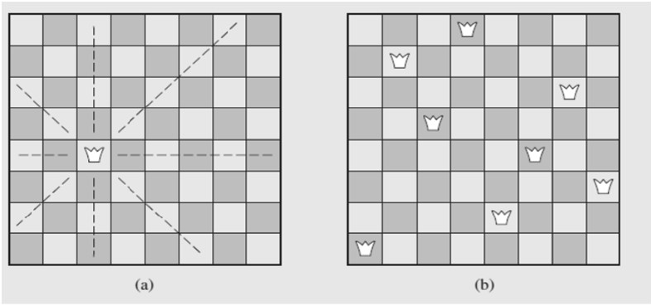
N-Queen Problem
Idea of the size of the problem:
There are 4,426,165,368 ways to arrange 8 queens on a chessboard of 64 squares.
No queen can reside in a row or a column that contains another queen
only 40,320 (8!) arrangements of queens to be checked for attacks along diagonals

Slide 18
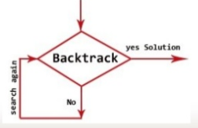
Back Tracking
Backtracking is an algorithmic technique for solving problems recursively by trying to build a solution incrementally, one piece at a time, removing those solutions that fail to satisfy the constraints of the problem at any point of time.

Slide 19
Backtracking Algorithm
The idea is to place queens one by one in different columns, starting from the leftmost column. When we place a queen in a column, we check for clashes with already placed queens.
In the current column, if we find a row for which there is no clash, we mark this row and column as part of the solution. If we do not find such a row due to clashes then we backtrack and return false.

Slide 20
Backtracking Algorithm
Start in the leftmost column
If all queens are placed
return true
Try all rows in the current column. Do following for every tried row.
If the queen can be placed safely in this row then mark this [row, column] as part of the solution and recursively check if placing queen here leads to a solution.
If placing the queen in [row, column] leads to a solution then return true.
If placing queen doesn't lead to a solution then unmark this [row, column] (Backtrack) and go to step (a) to try other rows.
If all rows have been tried and nothing worked, return false to trigger backtracking.

